Slide 1
HEALTHCARE UNMASKED
BY MEDILYTICS
Bhuvan K B | Hari Priya Yadlapalli | Puneetha B | Rutuja Samant
Vaibhavi Hedaoo | Vineet Chheda | Weslee Hwang | Zeba Karkhanawala

Slide 2
TABLE OF CONTENTS
1.
Introduction
4.
Changing Vulnerability to Diseases
2.
5.
Data Cleaning
Fair Market Pricing
3.
6.
Demographic Factors and Disease
Conclusion
Problem/Mission Statement and Dataset Overview
Trends impacts of disease on patients
Prep data for analytics
Price trends predictions to increase profits
Ending Statements
Medical trends within subsets demographics
Notes:
USE THIS IF YOUR SLIDE CAN INCORPORATE THIS!

Slide 3
INTRODUCTION
Exploring Healthcare Dynamics
in New York: A Comprehensive Analysis

Slide 4
Problem Statement
How has medical diagnostics and procedures trends changed over time within New York?

Slide 5
Why?
Pioneer Healthcare Planning
Assist Policymaker, Healthcare Researchers, and Hospital Administrators
Population Dynamics
Demographics Analytics and Addressing Trends in Healthcare

Slide 6
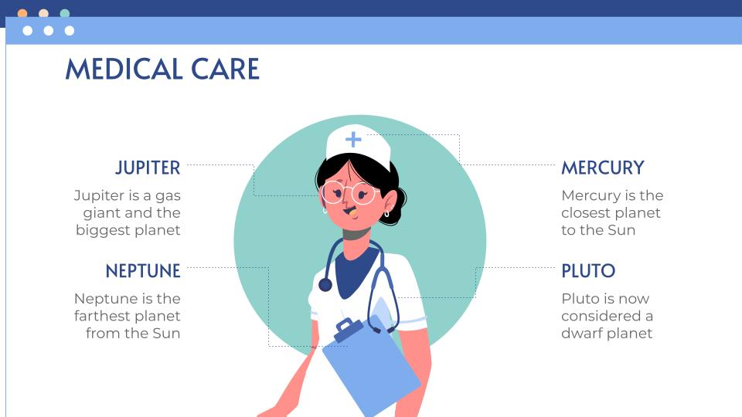
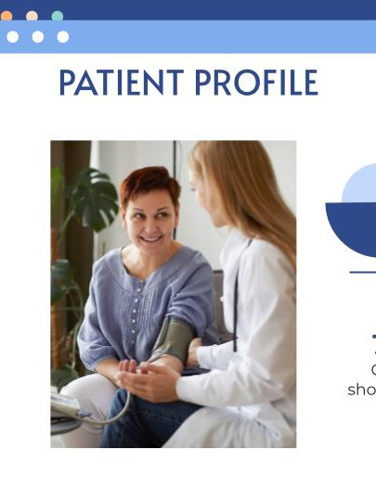

Mission Statement
Create a healthcare analytics platform to extract valuable insights from medical data.

Slide 7
Dataset Overview
Utilizing a de-identified dataset of Inpatient Discharges from diverse New York Hospitals
Location:
New York State
Data Description:
Hospital Inpatient Discharges
Observations:
Demographic Data, Hospital Data, Diagnosis, Procedure, and Payment

Slide 8



Analysis
Demographic Factors and Disease
Changing Vulnerability to Diseases
Evolution of Treatment Protocol
Notes:
Here is the PROBLEMS that would be solved, how these analysis will help SOLVE problems in real life: The answers to these questions can contribute significantly to addressing various healthcare challenges and shaping informed strategies:
1. Demographic Factors and Disease
Impact on Healthcare Policy: Understanding how demographic factors correlate with disease contraction and treatment helps tailor healthcare policies. For instance, if certain demographics are more prone to a particular disease, targeted preventive measures and healthcare resources allocation can be implemented.
Healthcare Access: Identifying demographic groups vulnerable to specific diseases allows for improved access to healthcare services, ensuring these populations receive adequate screenings, vaccinations, or targeted interventions.
2. Changing Vulnerability to Diseases
Early Intervention: Recognizing shifts in vulnerability aids in early intervention strategies. For diseases that show increasing prevalence in specific demographics, proactive measures like public health campaigns or educational programs can be initiated to mitigate risks.
Resource Allocation: Awareness of changing disease vulnerability guides resource allocation. Hospitals and healthcare systems can prepare by investing in specialized treatments or training for healthcare professionals to handle emerging healthcare needs.
3. Evolution of Treatments
Enhancing Treatment Protocols: Understanding how treatments for diseases have evolved over time helps in refining treatment protocols. This knowledge aids in adopting more effective treatments, reducing mortality rates, and improving patient outcomes.
Technological Advancements: Identification of advancements in treatments can prompt the integration of innovative technologies or methodologies into healthcare practices, ensuring patients receive the most current and effective care available.
Overall Contribution to Issue Resolution:
Informed Decision-making: Answers to these questions provide data-driven insights for policymakers, healthcare administrators, and researchers, empowering them to make informed decisions on resource allocation, healthcare planning, and policy formulation.
Optimized Healthcare Delivery: By tailoring interventions based on demographic vulnerabilities, healthcare systems can better address the needs of specific populations, leading to more efficient and effective healthcare delivery.
Public Health Improvement: Addressing these aspects can contribute to overall public health improvement by reducing disease burdens, optimizing healthcare resources, and enhancing the quality of healthcare services provided to diverse populations.
By leveraging the analysis insights into these questions, healthcare systems can strategically address emerging healthcare challenges, allocate resources efficiently, and ultimately improve healthcare access and outcomes for the population.

Slide 9
2.
Data Cleaning

Slide 10
Data cleaning:
Sampling the Data
Data cleaning
02
04
01
03
Merge Data
05
Acquiring
Exploratory Data Analysis
Notes:
Acquiring Data
Exploratory Data Analysis
Drop Columns
Merge Data
Find Redundant Data
Check for Consistency
Null Values Handling
Sampling the Data
Encode Data

Slide 11
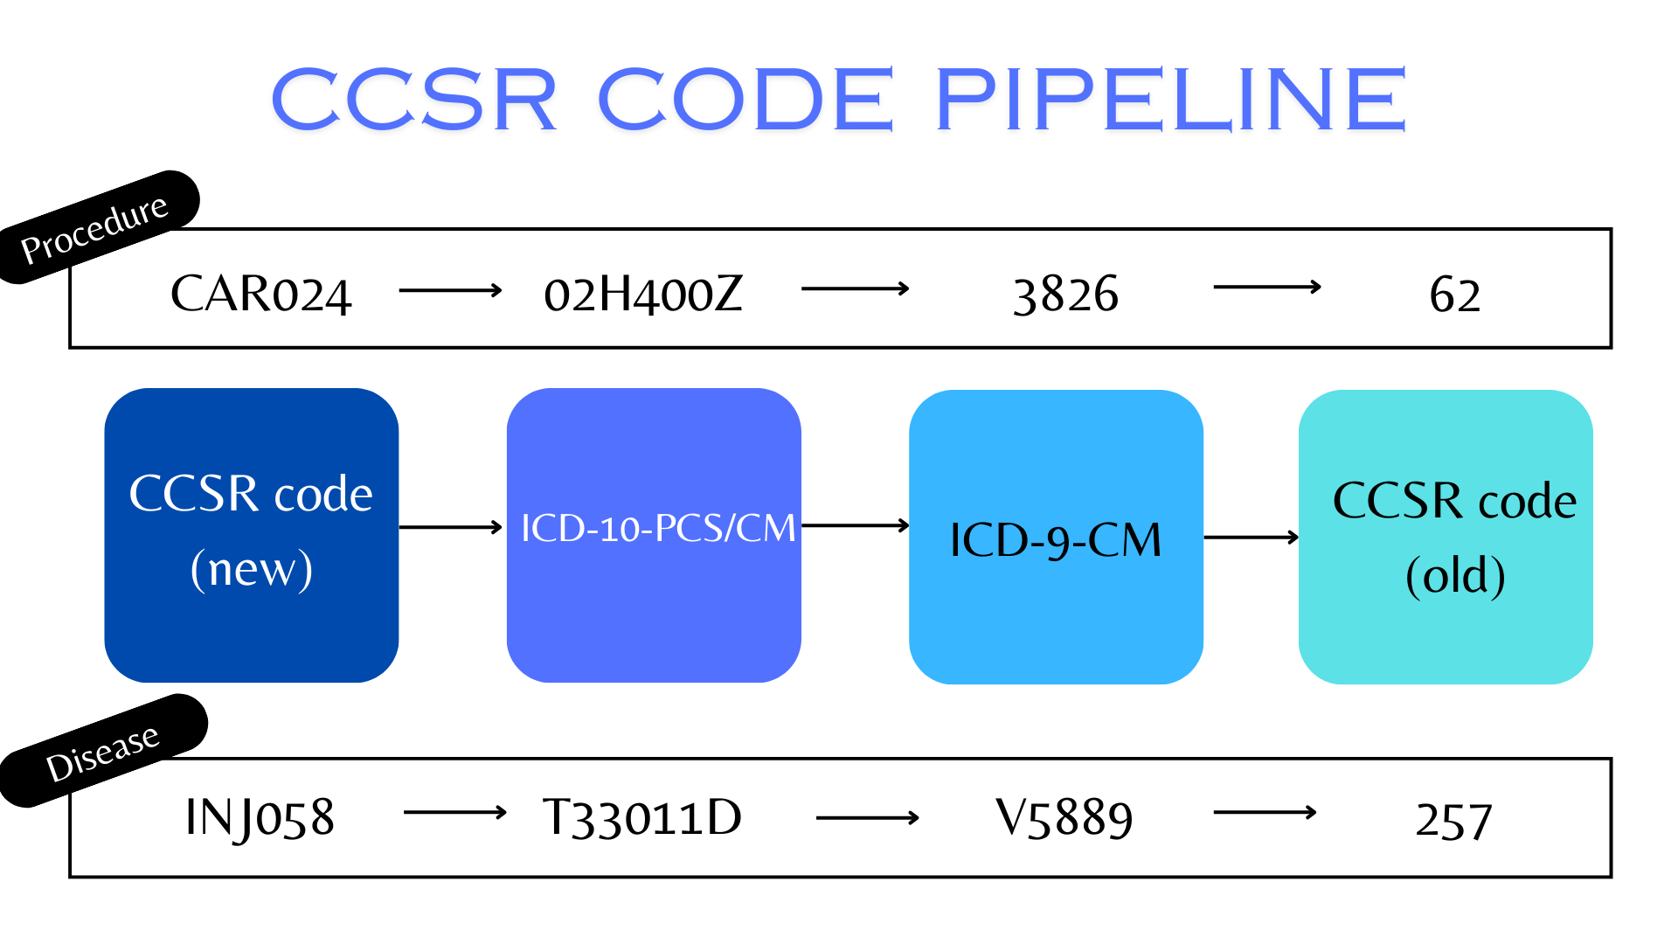

Slide 12
ANALYSIS #1
What is the impact of population demographics on the contraction of diseases?

Slide 13
WHY?
01
02
03
Identification of Risk Groups
Personalized Medicine
Public Health Policy and Resource Allocation

Slide 14
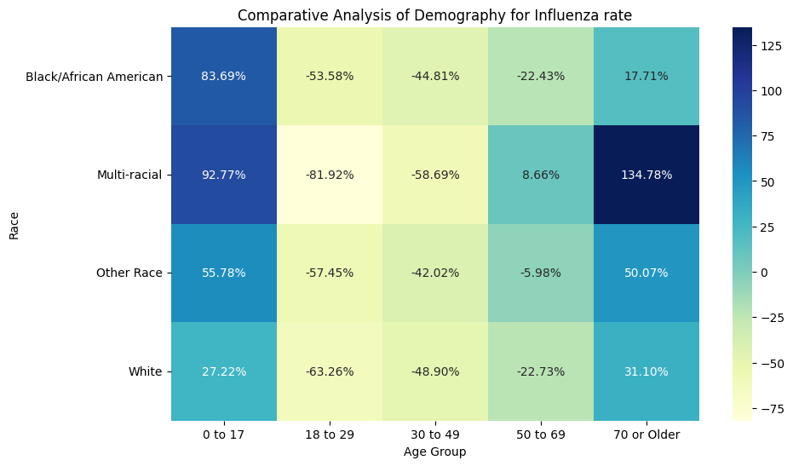
Visualization:

Slide 15
INFERENCES:
More cases in younger/older population due to low-immunity
Good genetic mix results in lower susceptibility for multi-racial patients

Slide 16
ANALYSIS #2
How has the population's vulnerability to certain diseases changed over the years?

Slide 17
WHY?
01
02
03
Insights/trends into disease prevalence
Potential shifts in susceptibility
Effectiveness of healthcare interventions.

Slide 18
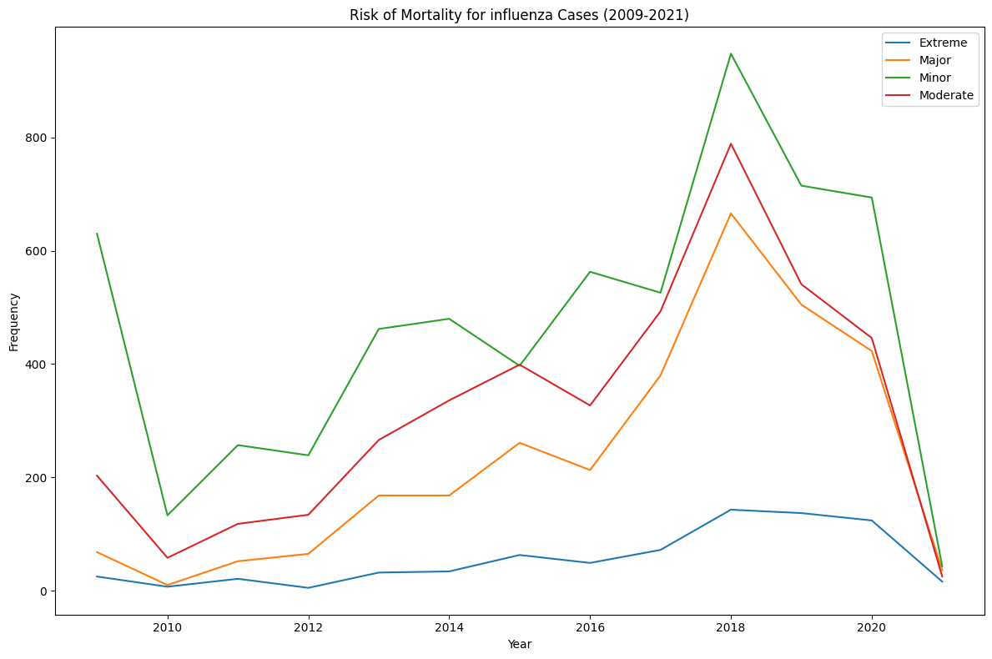
Visualization:

Slide 19
INFERENCES:
Decreased cases in 2009 due to increased vaccine awareness
Reduced vaccine effectiveness/dominant strain H3N2
Misdiagnosis due to COVID-19 after 2020

Slide 20
ANALYSIS #3
Is there a way hospitals can better predict discharge costs and decrease the difference between the estimated charge and actual charges incurred at the time of discharge?

Slide 21
WHY?
01
02
03
Better finance management
Informed Decision-Making for patients
Financial Transparency

Slide 22
Regression Model Output:
Year: 2010
Average Predicted Charges: 33986.58
Average Predicted Costs: 12934.24
Year: 2011
Average Predicted Charges: 34971.38
Average Predicted Costs: 12841.06
Year: 2012
Average Predicted Charges: 36738.26
Average Predicted Costs: 12772.37
Year: 2013
Average Predicted Charges: 41076.18
Average Predicted Costs: 13284.79
Year: 2014
Average Predicted Charges: 43521.53
Average Predicted Costs: 14006.15
Year: 2015
Average Predicted Charges: 46437.2
Average Predicted Costs: 15145.97
Year: 2016
Average Predicted Charges: 49317.16
Average Predicted Costs: 16105.39
Year: 2017
Average Predicted Charges: 52752.49
Average Predicted Costs: 16404.33
Year: 2018
Average Predicted Charges: 55203.11
Average Predicted Costs: 16439.11
Year: 2019
Average Predicted Charges: 57680.02
Average Predicted Costs: 16878.1

Slide 23
INFERENCES:
Medical Advancements
Negotiations with Suppliers and Providers
Vaccination Campaigns
Healthcare Policy Changes

Slide 24
6. Conclusion
Prepare
Profits
Trends
Expand
Optimize your hospital for future pandemics
Maximize profits
Stay on top of the medical trends
Compare your competitive advantage

Slide 25
Questions?

